Slide 1
Student Growth Workshop #4
Tying it all together

Slide 2
REview
Who?
How much growth?
What assessments?
When?
Where?—eVal

Slide 3
Learning goal
Teachers will be able to input student growth goal, start to plan assessments to document growth, and reflect on growth.

Slide 4
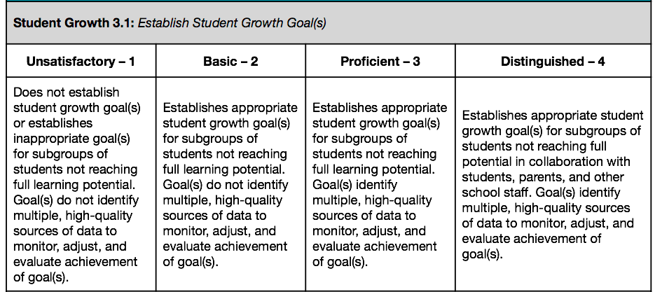
State laws and expectations

Slide 5
Reflection
Evaluate and Reflection
How are the students doing?
What can I change to help?
What can’t I change that might be impacting the data?
What might need to be adjusted before the end of the year/data timeframe?

Slide 6
Sharing
Goals are being asked to be submitted today. What questions do you still have about them?
Anyone willing to share their goals for feedback?
Any Marzano or TPEP questions?

Slide 7
Closing
Thank you for your time. Please make sure you have your time cards ready. Any questions down the road please feel free to call or email me.
jwarren@omaksd.org
509 826 7697

